Slide 1
Chat Application

Slide 2
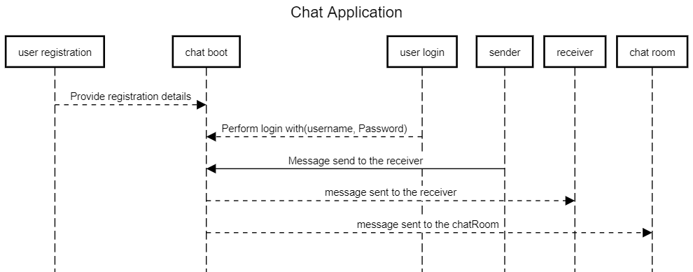
Sequence Diagram

